Slide 1

MX2020 Big Data
Data Leke Reference Architecture
Alerts and Notifications
March 19, 2020

Slide 2
Change control
Versión | Fecha | Descripción del Cambio | Autor/Departamento
0.1 | 10/05/2019 | Creation of the document | [Big Data Architecture] Susana Edith Barrientos Galicia

Slide 3
Table of Contents
Features and terminology
Needs and Solution Proposal
Graphic Representation of the Solution
Infrastructure and Connectivity
General services
Risks and Dependencies
Standards, Patterns and Decisions of Architecture
References and Annexes

Slide 4
Features and terminology

Slide 5



Features and terminology (I)
Data Lake - Alerts and Notifications
Data Sources
Acquisition & Ingest layer
Processing Layer
Abinitio
Raw
Curated
Augmented
Layers of Architecture of a Data Lake
Batch Layer
N... node
Functional division for the data life cycle
Hue
Hue
Sentry, Kerberos
UI Framework
SDK
Workflow
Workflow
Hive
Oozie
Scheduler
Metadata
Languages, Compilers
Fast read / write access
Flume, Sqoop
Pig / Hive
HBase
Data Integration
Components of the batch layer
HDFS
Hadoop Distributed File Systems
Job
Spark
Processing
YARN
Resources Manager
Zookeeper
Coordination
cloudera
Data Lake

Slide 6
Needs and Solution Proposal (I)
Descripción de la solución técnica
Objective
Define core components, pieces of code for the Data Lake Notification and Alerts project architecture
Scope
Represent graphics of the components, internal structure and integrations, incorporating the use of good design and development practices in the different phases of the software engineering process.
Description
Due to the reengineering of the Architecture of the Alerts and Notifications area, the following functionalities for the Data Lake are identified:
Validate the structure of the Event
Move Row Zone data to Cured
Process the data according to certain Alerts and Notifications business rules, make a view available for the visualization tool
Completeness and data quality

Slide 7

Needs and Solution Proposal (II)
New component
Component to modify
Data Lake - Alerts and Notifications – Global Architecture
Component not contemplated
General flow
Data Sources
Serving Layer
Integration with Hadoop components
Acquisition & Ingest layer
Processing Layer
A
B
Abinitio
Raw
Curated
Augmented
1.
Visualization Tool
Abinitio ETL sends the Json file with the events of the day to the Zona Row
El Job de Data Lake valida la existencia del archivo y la estructura del Json
The Data Lake Job validates the existence of the file and the structure of the Json
The Data Lake job moves Row data to Cured by creating the table in Hive, processes the information based on the Alerts and Notifications business rules
The Data Lake Job creates a view in Hive with the data it processes to make it available to the tool in visualization
4.
Batch Layer
N... node
Hue
Hue
Sentry, Kerberos
UI Framework
SDK
Workflow
Workflow
Hive
Oozie
Scheduler
Metadata
Languages, Compilers
Fast read / write access
Flume, Sqoop
Pig / Hive
HBase
Data Integration
A
2.
HDFS
Hadoop Distributed File Systems
B
Job
Spark
Processing
3.
YARN
Resources Manager
Zookeeper
Coordination
cloudera

Slide 8
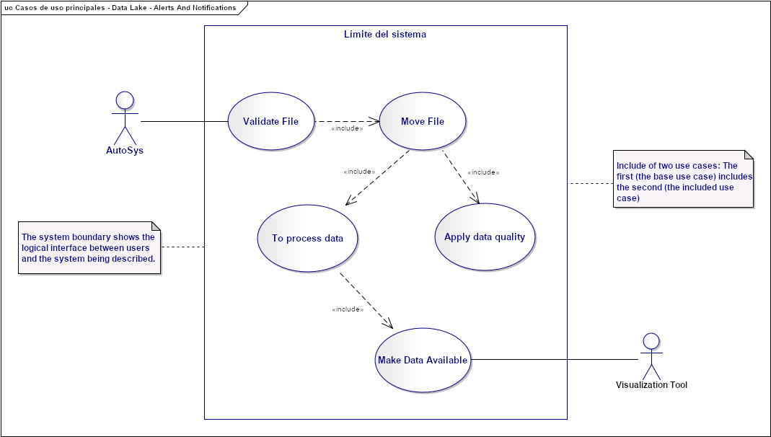
Needs and Solution Proposal (III)
Event Hub Architecture – Use Case View
Validate File:
Move File:
Top process data:
Apply data quality:
Make Data Available
1.
2.
3.
4.
5.

Slide 9
Needs and Solution Proposal (IV)
Event Hub Architecture – Use Case View II
Validate File:
Move File:
Top process data:
Apply data quality:
Make Data Available

Slide 10
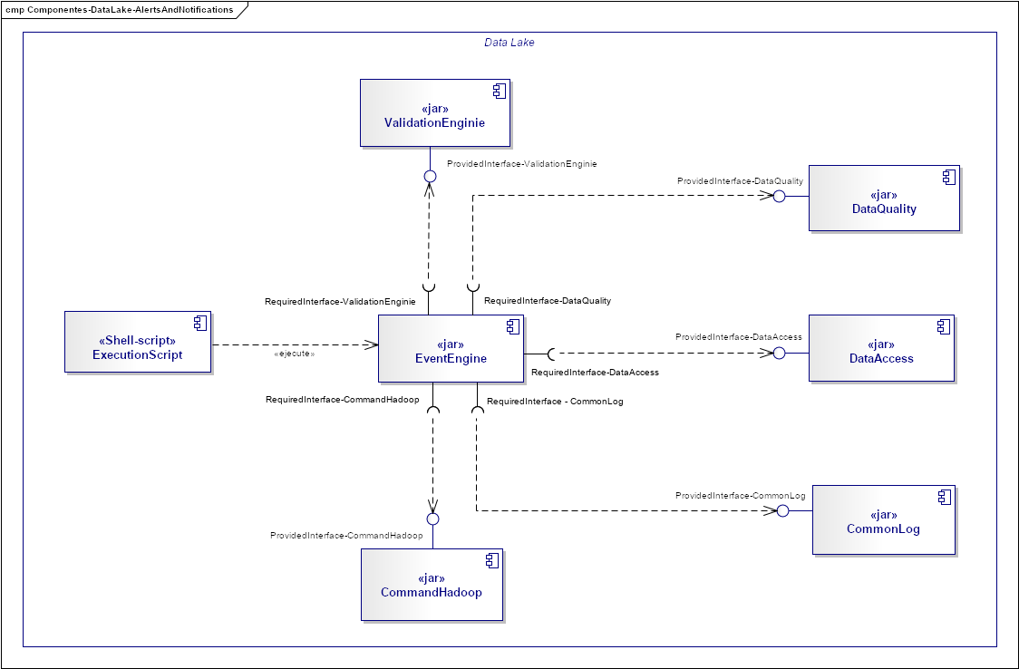
Needs and Solution Proposal (III)
New component
Component to modify
Data Lake - Alerts and Notifications - Component View
Component not contemplated first phase
EventEngine: It is the component that is responsible for providing a common interface to process events, it contains the business logic of different projects that require processing for events
ValidationEnginie: It is the component that has the responsibility to perform the functionality of validating the structures of the events, it is contemplated to scale the component for validations in different projects, allowing reuse
DataAccess: It is the component that has the responsibility to provide a common interface for access to different resources, both Hadoop and outside the Data Lake
CommandHadoop: It is the component that is responsible for providing a common interface to execute Hadoop commands
Shell-Script: It is in charge of executing the "EventEngine" component to orchestrate the functionalities required for the attention flow to the Alerts and Notifications project.
6.
2.
5.
c
1.
3.
7.
4.

Slide 11
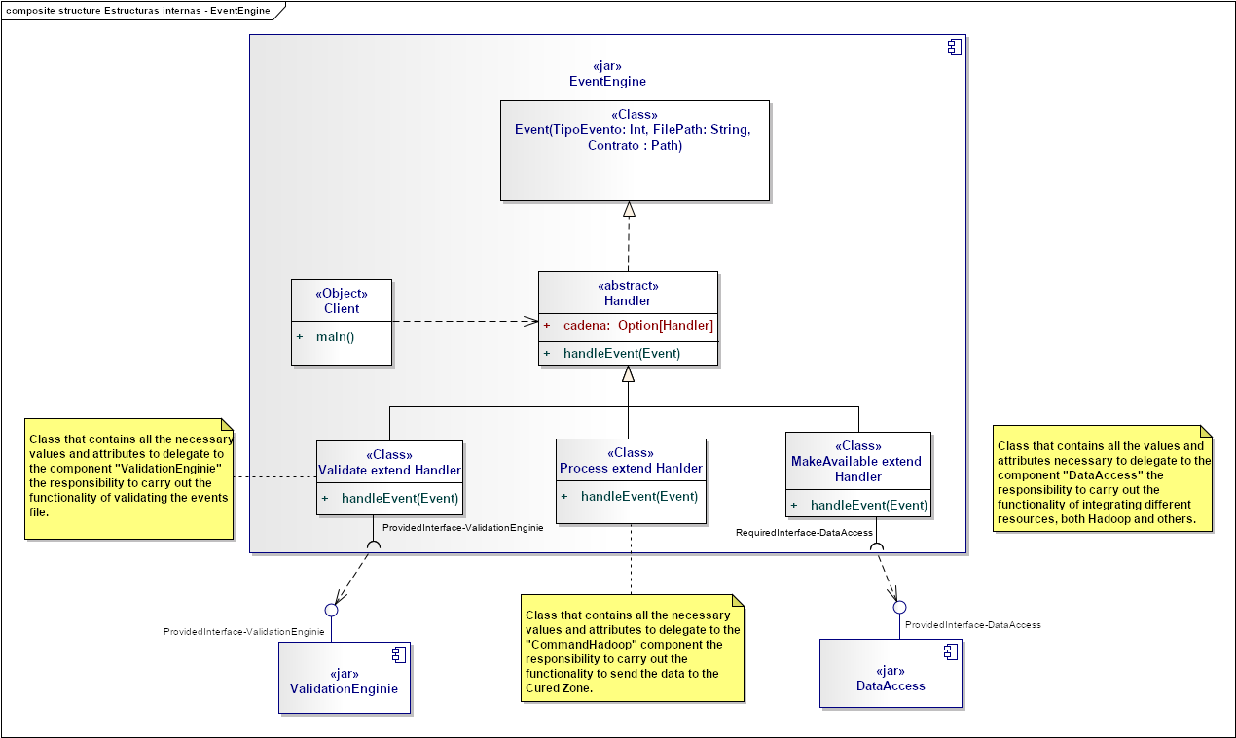
Needs and Solution Proposal (IV)
Data Lake - Alerts and Notifications - Component View II - EventEngine Internal structure

Slide 12
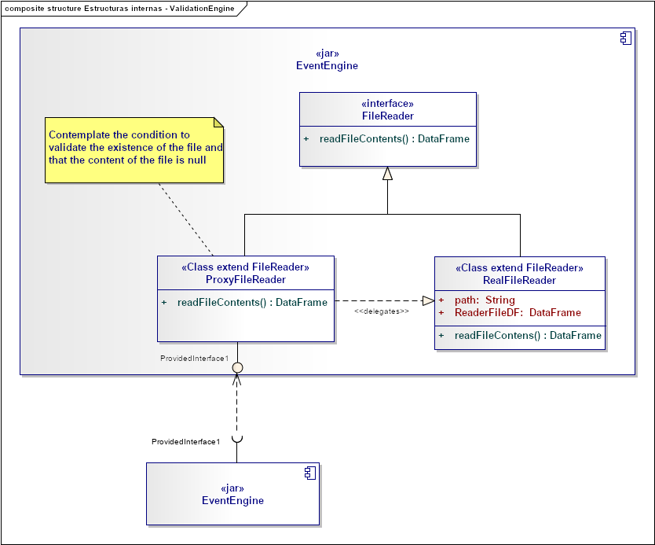
Needs and Solution Proposal (V)
Data Lake - Alerts and Notifications - Component View II - ValidationEngine Internal structure

Slide 13
Needs and Solution Proposal (VI)
Data Lake - Alerts and Notifications - Component View II - CommandHadoop Internal structure

Slide 14
Needs and Solution Proposal (VII)
Data Lake - Alerts and Notifications - Component View II - DataAccess Internal structure

Slide 15
Needs and Solution Proposal (VIII)
Data Lake - Alerts and Notifications – Deployment view

Slide 16
Data completeness

Slide 17
Data completeness
Resumen de Componentes de Infraestructura
With the fibnality of meeting the data complitness requirements, we present a generic view of the dimensions, and those we contemplate should be measured, based on near real time projects.
The quality of the data can refer to the extent of the data (i.e. the values of the data), or the tension of the data (the scheme)
The most common dimensions of data quality:
Dimensiones | Definiciones
Accesibilidad | Grado de disponibilidad de los datos o recuperación fácil y rápida
Cantidad apropiada de datos | Grado de cual volumen de datos es apropiado para la tarea en cuestión
Creibilidad | Grado en que los datos se consideran verdaderos y creíbles
Completo | Grado en el que no faltan datos y es de suficiente amplitud y profundidad para la tarea en cuestión
Representación consistente | Grado en que los datos se presentan en el mismo formato
Facilidad de manipulación | Grado en que los datos son fáciles de manipular y aplicar a diferentes tareas
Libre de errores | Grado en que los datos son correctos y confiables
Interpretabilidad | Grado en que los datos están en los idiomas, símbolos y unidades apropiados, y las definiciones son claras
Objetividad | Grado en que los datos son imparciales, sin prejuicios e imparciales
Pertinencia | Grado en que los datos son aplicables y útiles para la tarea en cuestión
Reputación | Grado en que los datos son altamente considerados en términos de su fuente y contenido

Slide 18
Data completeness
Data Quality Dimensions
Dimensiones | Definiciones
Seguridad | Grado en que el acceso a los datos se restringe de forma adecuada para mantener su seguridad
Oportunidad | Grado en que los datos están suficientemente actualizados
Comprensibilidad | Grado en que los datos se comprenden fácilmente
Valor añadido | Grado en que los datos son beneficiosos y proporciona ventajas de sus usos
Exactitud | La cercanía de la representación de un fenómeno de la vida real que un valor de datos intenta representar; medido por las funciones de comparación de distancia de edición
Correcto | Se denomina precisión sintáctica, que se refiere a la cercanía de un valor de datos con respecto a un dominio
Predominio | Preocupa la rapidez con que se actualizan los datos; puede medirse por los últimos metadatos actualizados
Volatilidad | Caracteriza la frecuencia con la cual los datos varían en el tiempo; métrica dada por la longitud de los datos de tiempo sigue siendo válida
Consistencia | Se refiere a la violación de las reglas semánticas definidas sobre los elementos de datos y generalmente expresa una restricción de integridad
Facilidad de comprensión | Cuantos datos son claros, sin ambigüedad y fácilmente comprensibles

Slide 19
Infrastructure and Connectivity

Slide 20
Infrastructure and Connectivity (I)
Resumen de Componentes de Infraestructura
Infrastructure component | Description | Applicability (New, Modified, Unmodified) | Application in which the component is located
Pendiente | Pendiente | Pendiente | Pendiente

Slide 21
Volumetría (I)
Case of use -
Characteristic | Detalle

Slide 22
Servicios Generales (I)
Seguridad
El detalle de los lineamientos mencionados están definidos en los documentos:
Standards for the creation of topics, development and security
Confidencialidad
Communication through mutual authentication and Kerberos between Data Lake
Auditoria:
Sending Logs to the Error Topic

Slide 23
Risks and Dependencies (I)
Coexistence
The detail of the mentioned guidelines are defined
Validate the integration standards with Data Lake, with Data Governance
Risks
El detalle de los lineamientos mencionados están definidos en los documentos:
Concept tests to integrate Kerberos between Data Lake

Slide 24
Risks and Dependencies (II)
Dependencias
El detalle de los lineamientos mencionados están definidos en los documentos:
Standard of Security Controls in Data Lake

Slide 25
Standards, Patterns and Decisions of Architecture (I)
Exceptions to Standards and Architecture Patterns
Pendiene

Slide 26
Standards, Patterns and Decisions of Architecture (II)
Architecture Decisions
Decisión | Premisas | Razonamiento de la Decisión
Pendienyte | Pendiente | Pendiente

Slide 27
Standards, Patterns and Decisions of Architecture (III)
Outbuildings
Dependencia | Componente externo a la solución que impacta | Fecha estimada en la que se requiere disponible
Not apply | Not apply | Not apply

Slide 28
References and Annex (I)
References
Nombre y version | Fecha | Comentarios | Rol/Departamento

